Slide 1

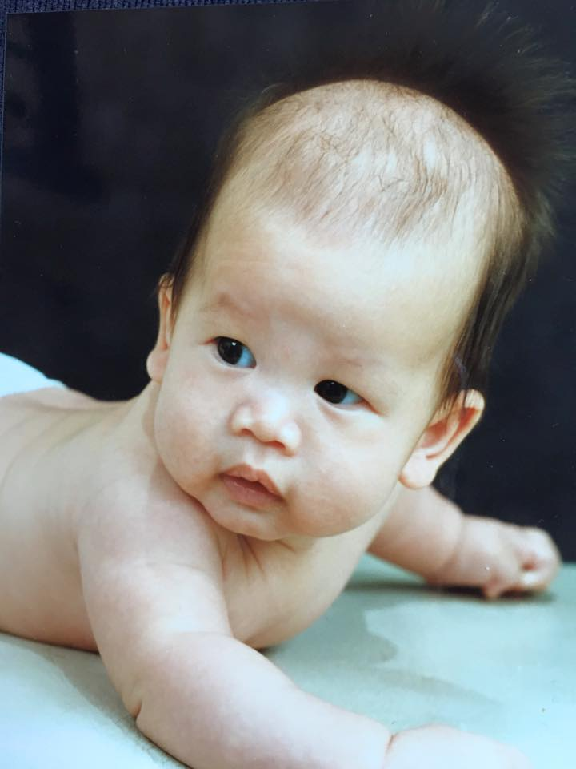
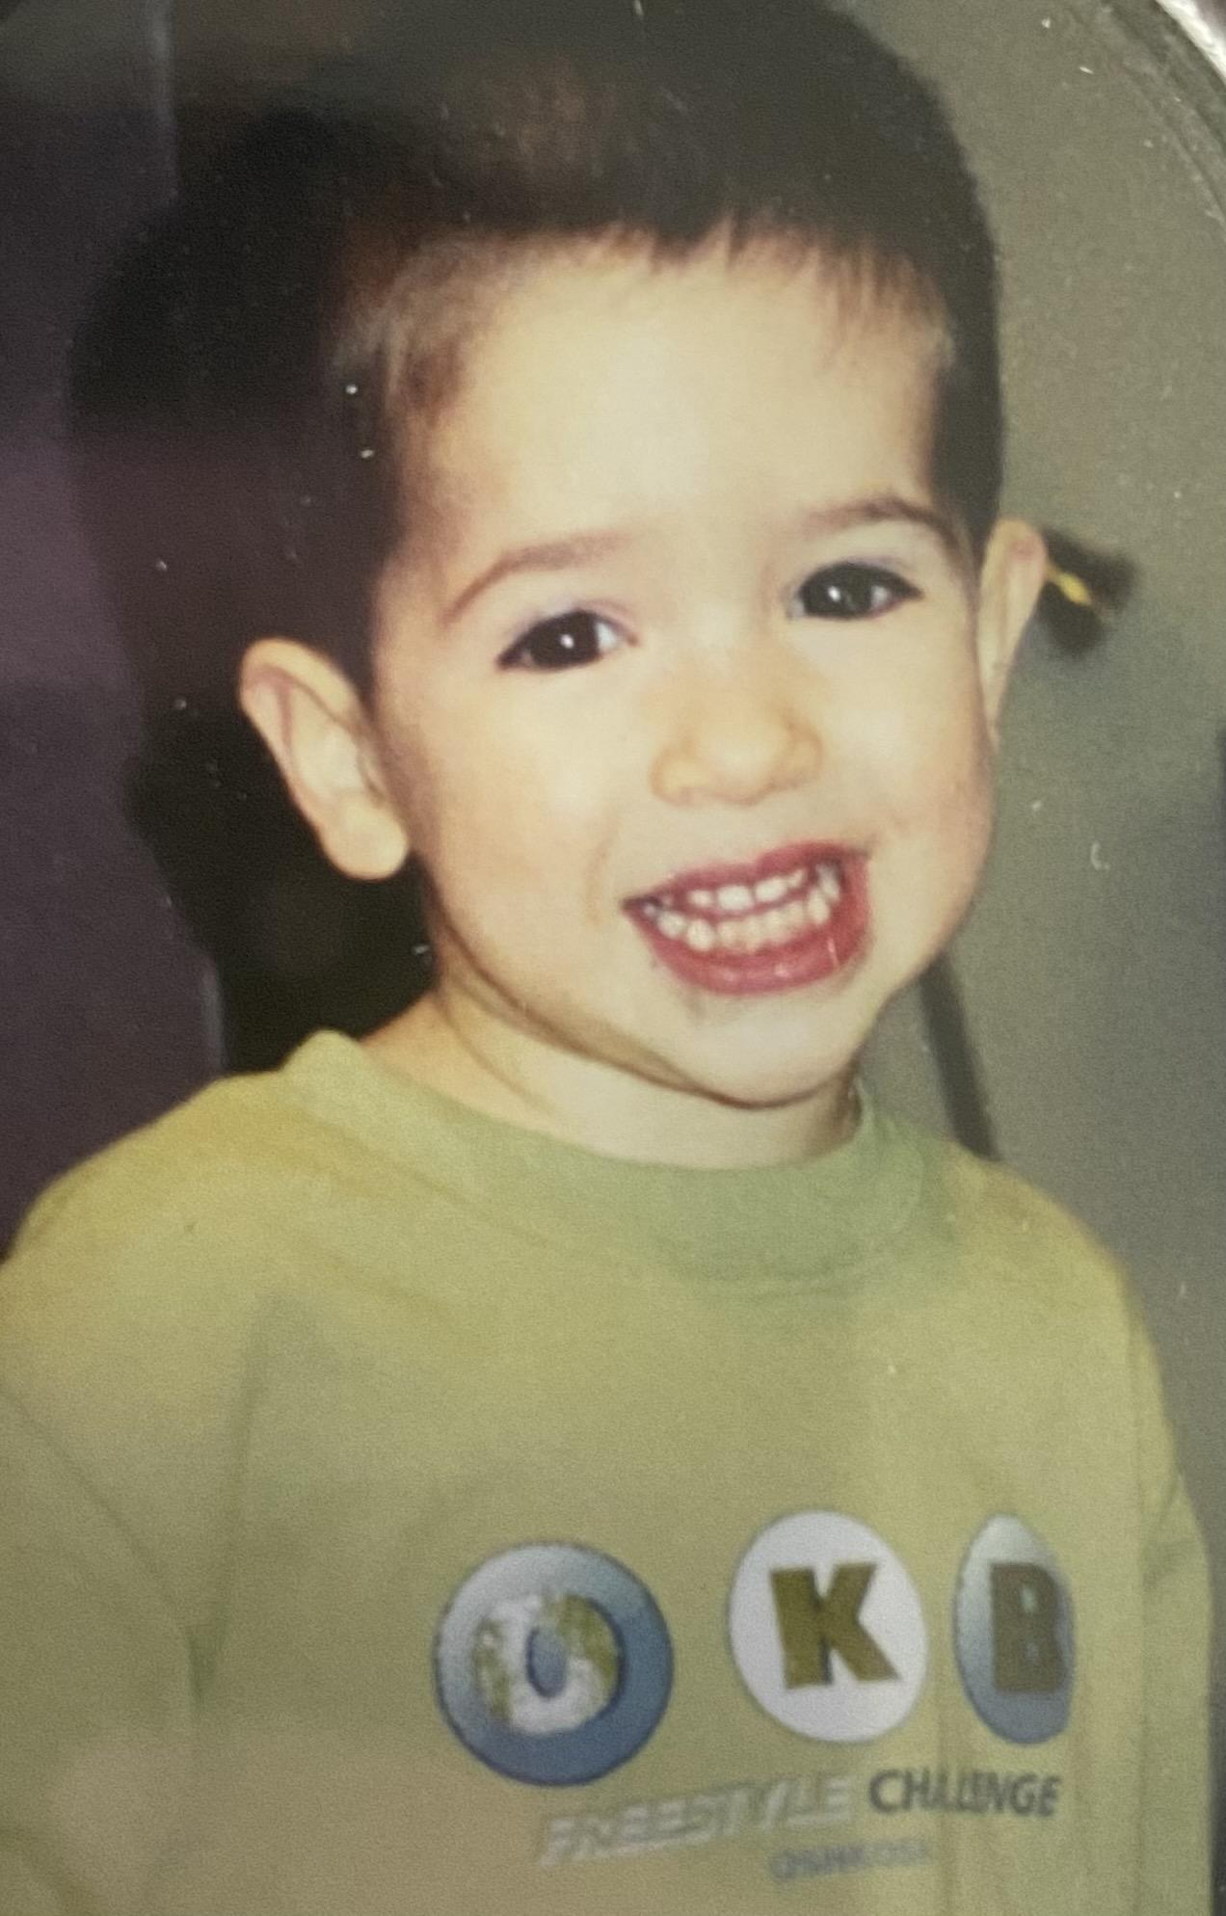
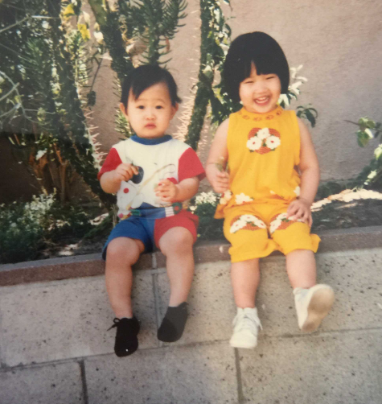
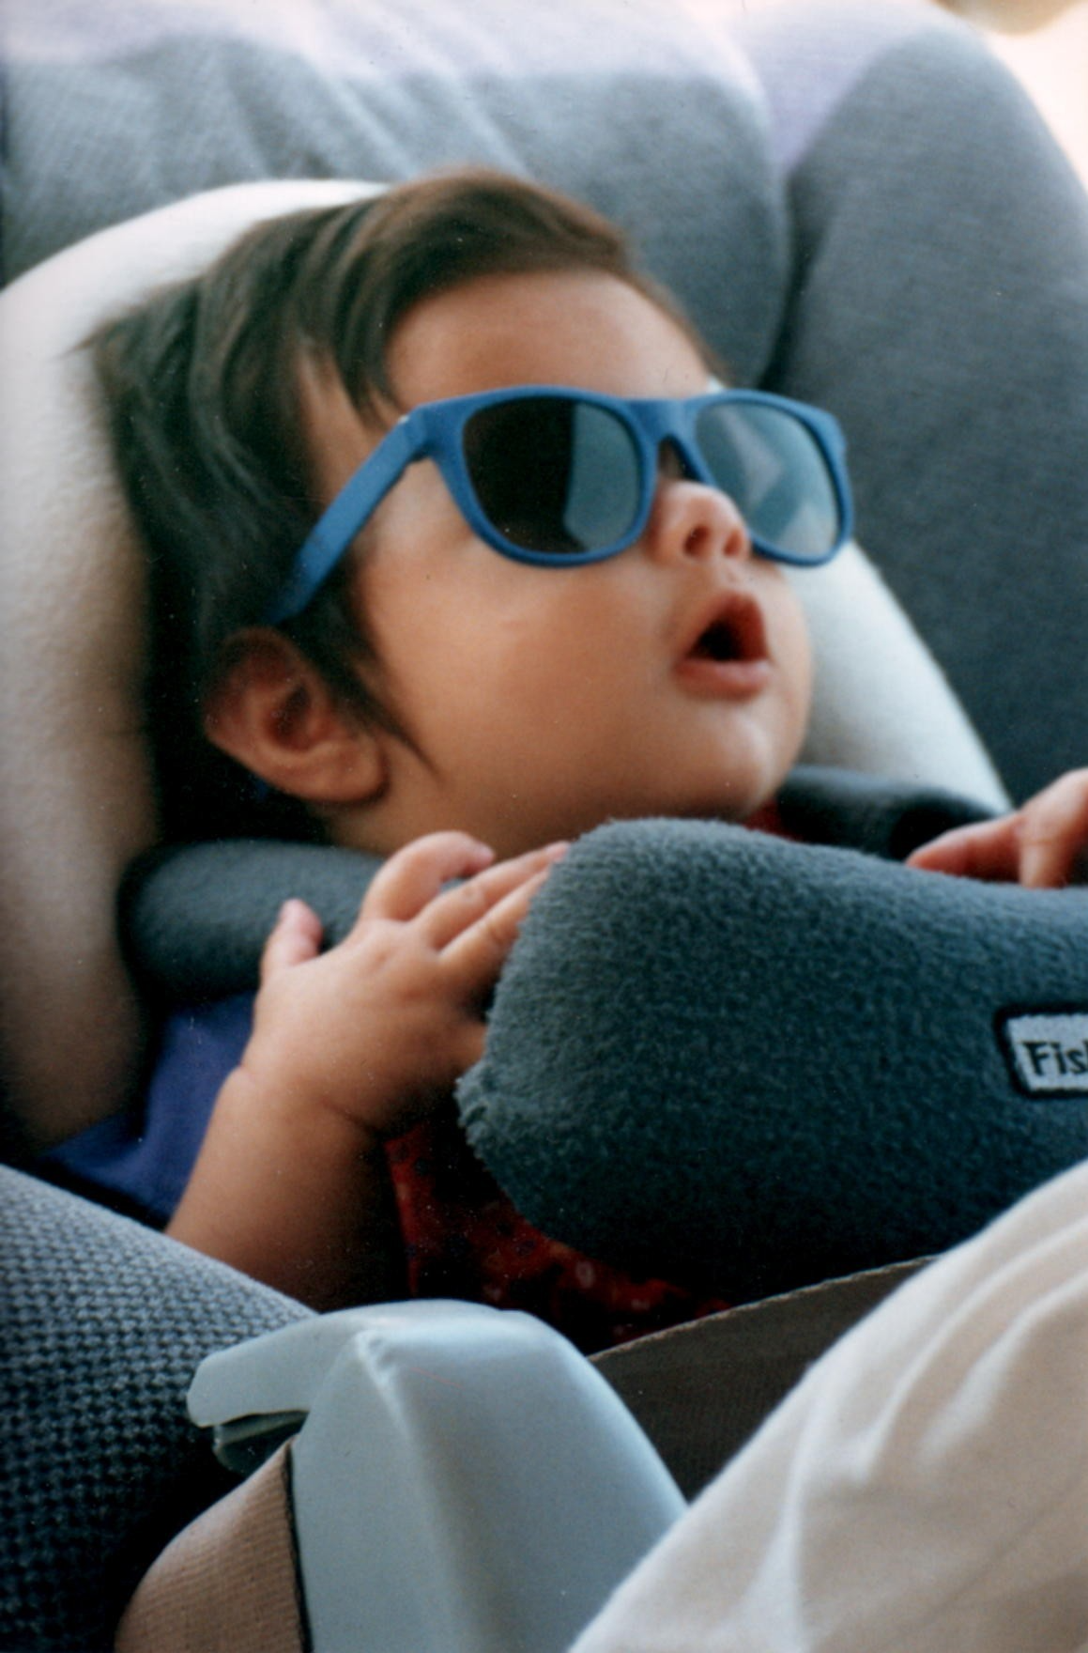
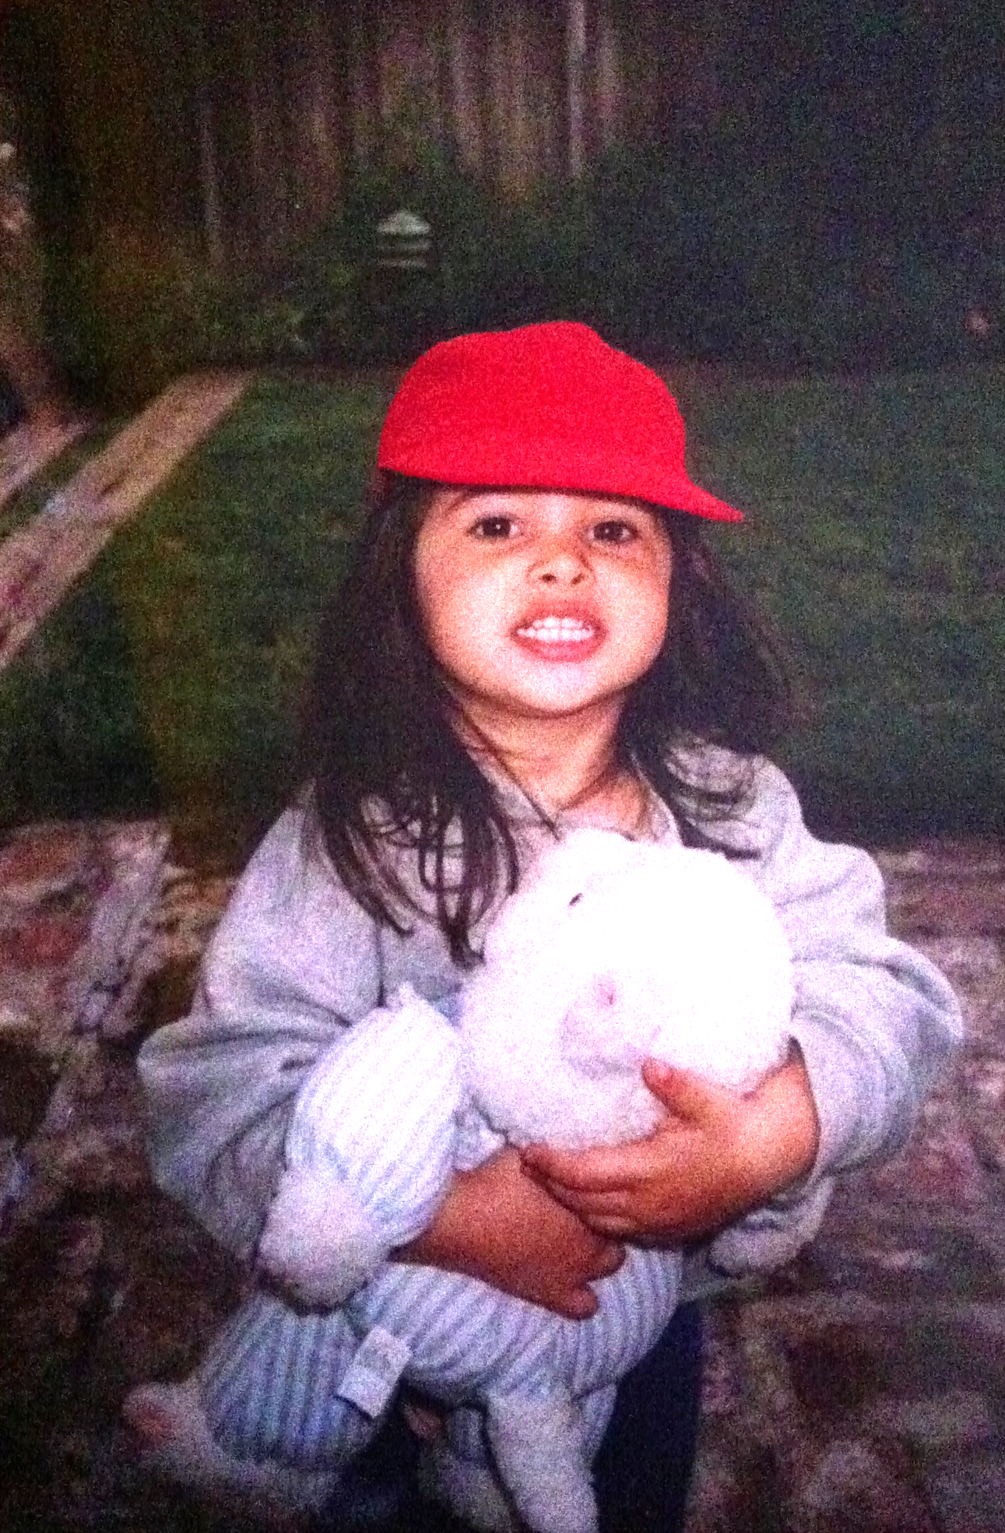
Drug Review Natural Language Processing
Karl Hickel
Bryan Sam
BRYAN SAM,
CAESAR PHAN,
KARL HICKEL,
MARIANNA CARINI
Marianna Carini
Caesar Phan

Slide 2
Introduction.
Dataset: UCI machine learning drug reviews
Obtained through crawling pharmaceutical review sites
214k reviews
6 features
Objective: Utilize NLP to extract insights on medication for prospective consumers
Challenge: Medical conditions have negative sentiment
Need to separate comments regarding condition from medication
Notes:
6 features:
Unique ID
Drug Name
Condition
Date
Review
Rating

Slide 3
Exploratory Data Analysis
Example of Positive Review:
Abilify changed my life. There is hope. I was on Zoloft and Clonidine when I first started Abilify at the age of 15.. Zoloft for depression and Clondine to manage my complete rage. My moods were out of control. I was depressed and hopeless one second and then mean, irrational, and full of rage the next. My Dr. prescribed me 2mg of Abilify and from that point on I feel like I have been cured though I know I'm not.. Bi-polar disorder is a constant battle. I know Abilify works for me because I have tried to get off it and lost complete control over my emotions. Went back on it and I was golden again. I am on 5mg 2x daily. I am now 21 and better than I have ever been in the past. Only side effect is I like to eat a lot.
Example of Negative Review:
I Ve had nothing but problems with the Keppera : constant shaking in my arms and legs and pins and needles feeling in my arms and legs severe light headedness no appetite and etc.
Notes:
Positive Review: Aripiprazole for bipolar
Negative Review: Keppra for Epilepsy

Slide 4
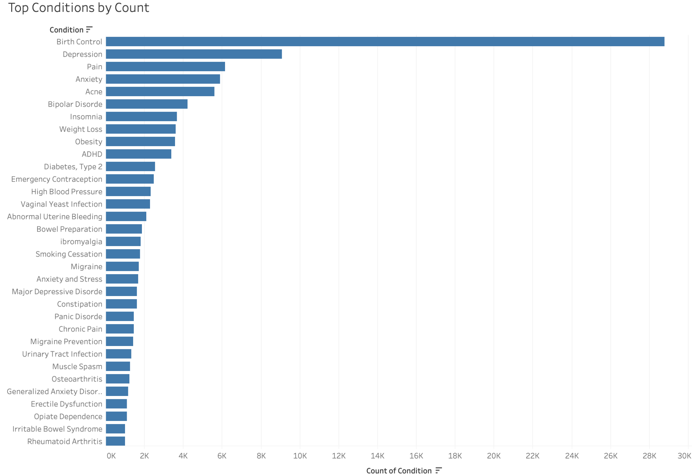
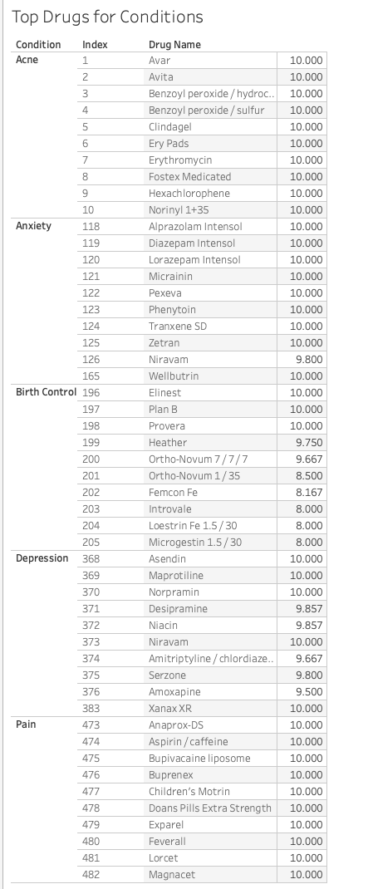
Exploratory Data Analysis (con’t.)
Notes:
Top Drugs are based on rating and do not take into consideration the number of reviews. This was filtered later.

Slide 5
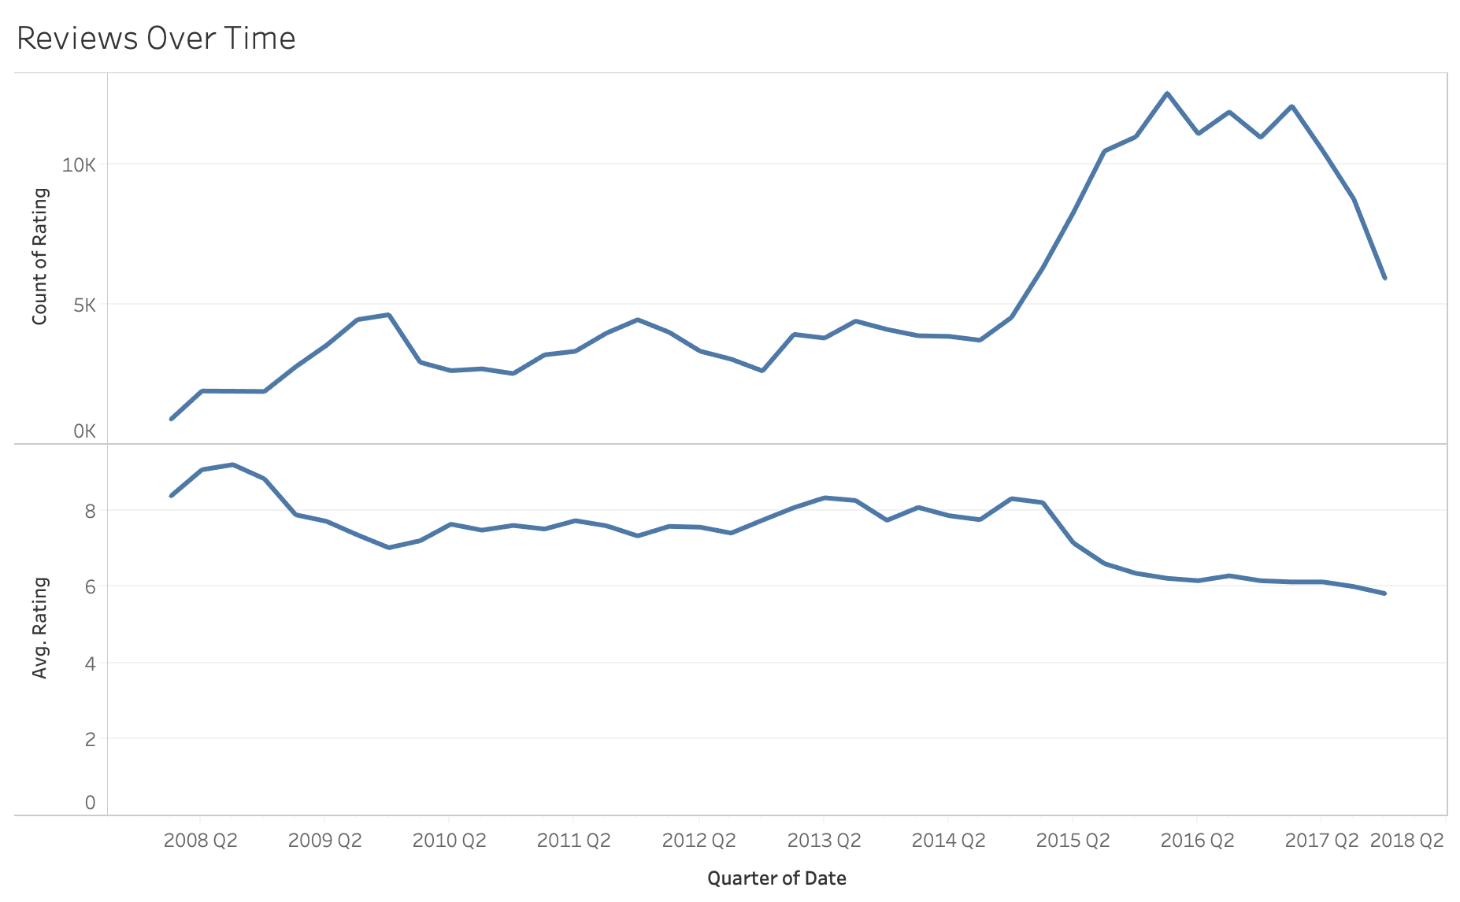
Exploratory Data Analysis (con’t.)
Notes:
Overview of drugs and average rating over time
Inversion: as ratings go down, looks more reviews are generated.

Slide 6
Predictive Model
Goal to predict whether a review was positive (rating of 7+) or negative
Intended to comb through thousands of reviews to extract insights for customers and providers
Scope:
Top five conditions: Depression, Birth Control, Anxiety, Pain, Acne
Drugs with 20+ reviews
Focus on precision
Base model using Vader
Precision: 77%
Notes:
Base model using Vader for rule-based
Vader does misclassify especially when a user describes horrendous sickness/condition but talking how a drug improves/treats

Slide 7
Predictive Model
Improved model by:
N-grams from 1 to 3 to add context
Removed stop words in data preprocessing
Implemented regularization
Precision: 80%
Issue: medical conditions are inherently negative
“I had a terrible headache, but it went away after taking Advil”
Need to parse data for medication to extract accurate insights

Slide 8
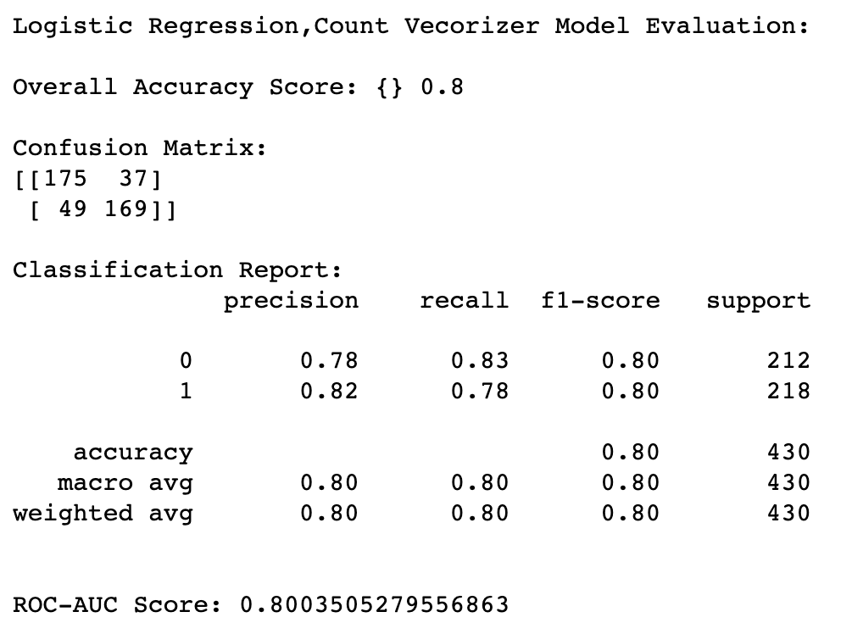
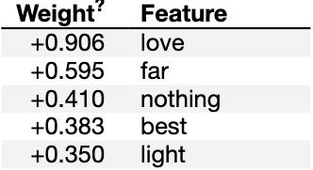
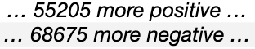
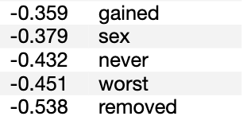
Model Results
Logistic Regression:
eli5:

Slide 9
Custom Medication Tag
Medications can be tagged as various PoS
Created list of keywords related to drugs (medication, pill, etc.)
Utilized spaCy to identify words connected with our keywords
Identified parents, children, and siblings
Included multiple “hops” to add context
Created bigrams with key and related words for additional context
Notes:
Hops: include the extent to which words identified in dictionary should be captured (i.e. 3 words away, 5 words, etc)

Slide 10
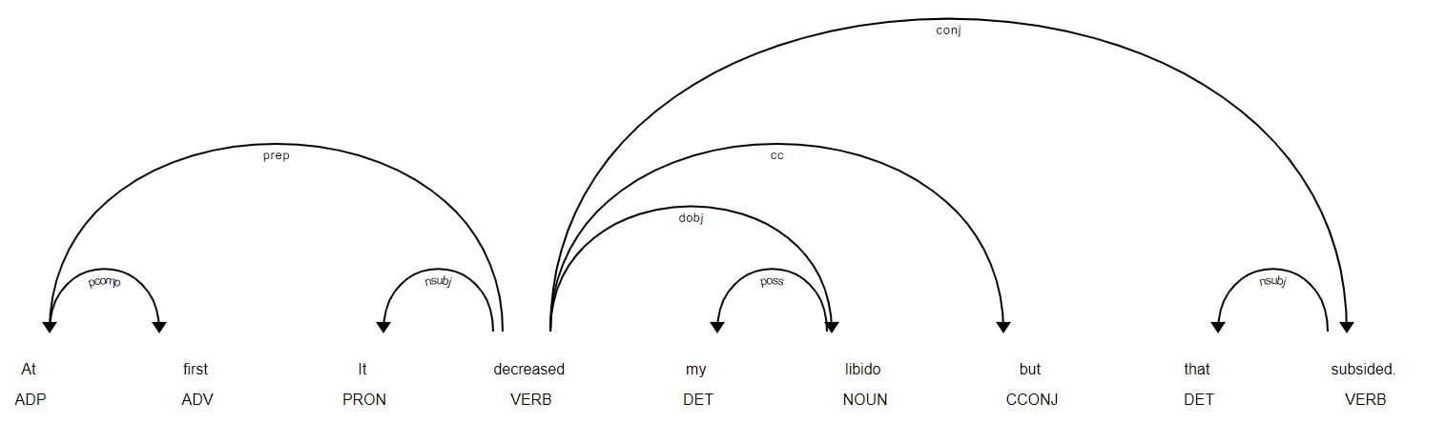
spaCy Example
Actual Bi-gram:
decreased:libido
(Incremental Effect:Condition)
Desired Tri-gram:
decreased: my, libido
Notes:
Example - This particular sentence is from a review of Ortho Evra for Birth Control. Using Spacy to visually render the review helps with building a dictionary of bigram with key words and its associated values. For instance, decreased libido.

Slide 11
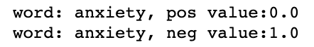
Example of Results
1 week on Zoloft for anxiety and mood swings. I take 50mg in the mornings with my breakfast. Nausea on day one but that subsided as the week went on. I get the jitters about 2 hrs after taking it followed by yawning. I feel much better though and less angry/stressed.
Baseline:
Predicts review as negative
Vader negative score: 0.141
Custom function:
Outputs: 'subsided after', 'subsided followed', 'subsided week', 'subsided mornings','subsided with'
Vader negative score: 0.0
Notes:
UniqueID = 96233 for this review

Slide 12
Conclusion
Can utilize spaCy to extract text pertaining to medications
Additional enhancements:
Find optimal number of hops
Base predictive model on custom tagging function
Look at alternatives to spaCy, like W2V
Look into various cut offs for positive reviews
Notes:
**Example where our feature improved results (like BoW/ wordcloud/ weights)**
Take example 75612, vader says negative, pull out results from custom tagging

Slide 13
Thank you!

